Slide 1
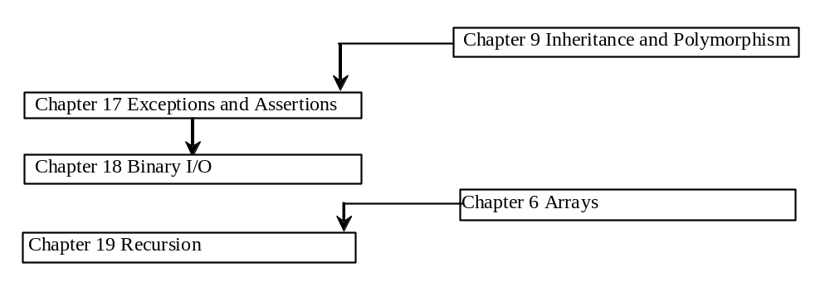
Chapter 17 Exceptions and Assertions

Slide 2
Objectives
To know what is exception and what is exception handling (§17.2).
To distinguish exception types: Error (fatal) vs. Exception (non-fatal), and checked vs. uncheck exceptions (§17.2).
To declare exceptions in the method header (§17.3).
To throw exceptions out of a method (§17.3).
To write a try-catch block to handle exceptions (§17.3).
To explain how an exception is propagated (§17.3).
To rethrow exceptions in a try-catch block (§17.4).
To use the finally clause in a try-catch block (§17.5).
To know when to use exceptions (§17.6).
To declare custom exception classes (§17.7 Optional).
To apply assertions to help ensure program correctness (§17.8).

Slide 3
Syntax Errors, Runtime Errors, and Logic Errors
You learned that there are three categories of errors: syntax errors, runtime errors, and logic errors. Syntax errors arise because the rules of the language have not been followed. They are detected by the compiler. Runtime errors occur while the program is running if the environment detects an operation that is impossible to carry out. Logic errors occur when a program doesn't perform the way it was intended to.

Slide 4
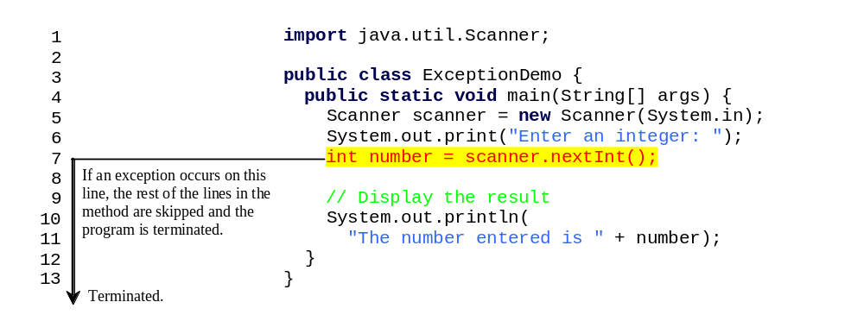
Runtime Errors
Run

Slide 5
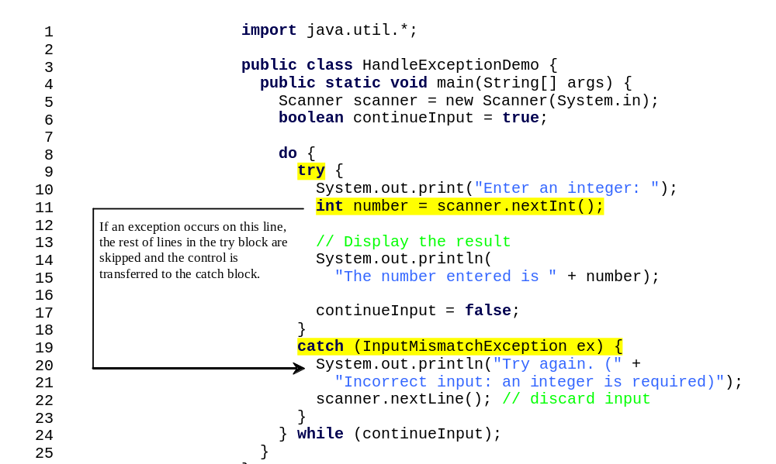
Catch Runtime Errors
Run

Slide 6

Exception Classes

Slide 7
System Errors
System errors are thrown by JVM and represented in the Error class. The Error class describes internal system errors. Such errors rarely occur. If one does, there is little you can do beyond notifying the user and trying to terminate the program gracefully.

Slide 8
Exceptions
Exception describes errors caused by your program and external circumstances. These errors can be caught and handled by your program.

Slide 9
Runtime Exceptions
RuntimeException is caused by programming errors, such as bad casting, accessing an out-of-bounds array, and numeric errors.

Slide 10
Checked Exceptions vs. Unchecked Exceptions
RuntimeException, Error and their subclasses are known as unchecked exceptions. All other exceptions are known as checked exceptions, meaning that the compiler forces the programmer to check and deal with the exceptions.

Slide 11
Unchecked Exceptions
In most cases, unchecked exceptions reflect programming logic errors that are not recoverable. For example, a NullPointerException is thrown if you access an object through a reference variable before an object is assigned to it; an IndexOutOfBoundsException is thrown if you access an element in an array outside the bounds of the array. These are the logic errors that should be corrected in the program. Unchecked exceptions can occur anywhere in the program. To avoid cumbersome overuse of try-catch blocks, Java does not mandate you to write code to catch unchecked exceptions.

Slide 12

Checked or Unchecked Exceptions
Unchecked exception.

Slide 13

Declaring, Throwing, and Catching Exceptions

Slide 14
Declaring Exceptions
Every method must state the types of checked exceptions it might throw. This is known as declaring exceptions.
public void myMethod()
throws IOException
public void myMethod()
throws IOException, OtherException

Slide 15
Throwing Exceptions
When the program detects an error, the program can create an instance of an appropriate exception type and throw it. This is known as throwing an exception. Here is an example,
throw new TheException();
TheException ex = new TheException();
throw ex;

Slide 16
Throwing Exceptions Example
/** Set a new radius */
public void setRadius(double newRadius)
throws IllegalArgumentException {
if (newRadius >= 0)
radius = newRadius;
else
throw new IllegalArgumentException(
"Radius cannot be negative");
}

Slide 17
Catching Exceptions
try {
statements; // Statements that may throw exceptions
}
catch (Exception1 exVar1) {
handler for exception1;
}
catch (Exception2 exVar2) {
handler for exception2;
}
...
catch (ExceptionN exVar3) {
handler for exceptionN;
}

Slide 18
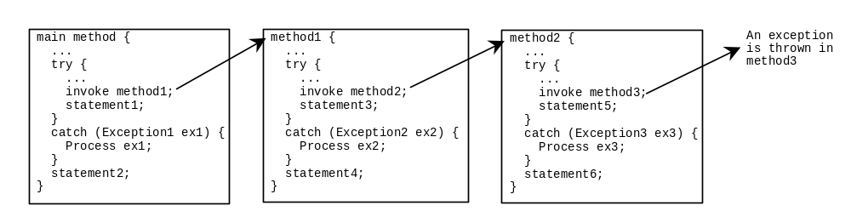
Catching Exceptions

Slide 19
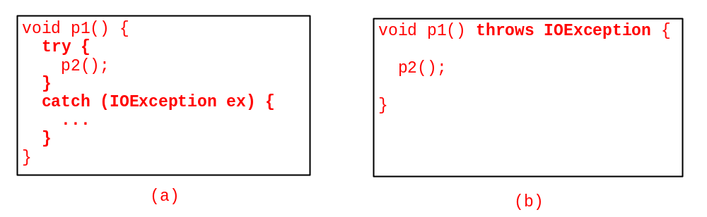
Catch or Declare Checked Exceptions
Java forces you to deal with checked exceptions. If a method declares a checked exception (i.e., an exception other than Error or RuntimeException), you must invoke it in a try-catch block or declare to throw the exception in the calling method. For example, suppose that method p1 invokes method p2 and p2 may throw a checked exception (e.g., IOException), you have to write the code as shown in (a) or (b).

Slide 20
Example: Declaring, Throwing, and Catching Exceptions
Objective: This example demonstrates declaring, throwing, and catching exceptions by modifying the setRadius method in the Circle class defined in Chapter 6. The new setRadius method throws an exception if radius is negative.
TestCircleWithException
CircleWithException
Run

Slide 21
Exceptions in GUI Applications
The methods are executed on the threads. If an exception occurs on a thread, the thread is terminated if the exception is not handled. However, the other threads in the application are not affected. There are several threads running to support a GUI application. A thread is launched to execute an event handler (e.g., the actionPerformed method for the ActionEvent). If an exception occurs during the execution of a GUI event handler, the thread is terminated if the exception is not handled. Interestingly, Java prints the error message on the console, but does not terminate the application. The program goes back to its user-interface-processing loop to run continuously.

Slide 22
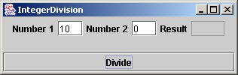
Example: Exceptions in GUI Applications
An error message appears on the console, but the GUI application continues running.
Write a program that creates a user interface to perform integer divisions. The user enters two numbers in the text fields Number 1 and Number 2. The division of Number 1 and Number 2 is displayed in the Result field when the Divide button is clicked.
IntegerDivision
Run

Slide 23
Rethrowing Exceptions
try {
statements;
}
catch(TheException ex) {
perform operations before exits;
throw ex;
}

Slide 24
The finally Clause
try {
statements;
}
catch(TheException ex) {
handling ex;
}
finally {
finalStatements;
}

Slide 25
Trace a Program Execution
animation
Suppose no exceptions in the statements
try {
statements;
}
catch(TheException ex) {
handling ex;
}
finally {
finalStatements;
}
Next statement;

Slide 26
Trace a Program Execution
animation
The final block is always executed
try {
statements;
}
catch(TheException ex) {
handling ex;
}
finally {
finalStatements;
}
Next statement;

Slide 27
Trace a Program Execution
animation
Next statement in the method is executed
try {
statements;
}
catch(TheException ex) {
handling ex;
}
finally {
finalStatements;
}
Next statement;

Slide 28
Trace a Program Execution
animation
try {
statement1;
statement2;
statement3;
}
catch(Exception1 ex) {
handling ex;
}
finally {
finalStatements;
}
Next statement;
Suppose an exception of type Exception1 is thrown in statement2

Slide 29
Trace a Program Execution
animation
try {
statement1;
statement2;
statement3;
}
catch(Exception1 ex) {
handling ex;
}
finally {
finalStatements;
}
Next statement;
The exception is handled.

Slide 30
Trace a Program Execution
animation
try {
statement1;
statement2;
statement3;
}
catch(Exception1 ex) {
handling ex;
}
finally {
finalStatements;
}
Next statement;
The final block is always executed.

Slide 31
Trace a Program Execution
animation
try {
statement1;
statement2;
statement3;
}
catch(Exception1 ex) {
handling ex;
}
finally {
finalStatements;
}
Next statement;
The next statement in the method is now executed.

Slide 32
Trace a Program Execution
animation
try {
statement1;
statement2;
statement3;
}
catch(Exception1 ex) {
handling ex;
}
catch(Exception2 ex) {
handling ex;
throw ex;
}
finally {
finalStatements;
}
Next statement;
statement2 throws an exception of type Exception2.

Slide 33
Trace a Program Execution
animation
try {
statement1;
statement2;
statement3;
}
catch(Exception1 ex) {
handling ex;
}
catch(Exception2 ex) {
handling ex;
throw ex;
}
finally {
finalStatements;
}
Next statement;
Handling exception

Slide 34
Trace a Program Execution
animation
try {
statement1;
statement2;
statement3;
}
catch(Exception1 ex) {
handling ex;
}
catch(Exception2 ex) {
handling ex;
throw ex;
}
finally {
finalStatements;
}
Next statement;
Execute the final block

Slide 35
Trace a Program Execution
animation
try {
statement1;
statement2;
statement3;
}
catch(Exception1 ex) {
handling ex;
}
catch(Exception2 ex) {
handling ex;
throw ex;
}
finally {
finalStatements;
}
Next statement;
Rethrow the exception and control is transferred to the caller

Slide 36
Cautions When Using Exceptions
Exception handling separates error-handling code from normal programming tasks, thus making programs easier to read and to modify. Be aware, however, that exception handling usually requires more time and resources because it requires instantiating a new exception object, rolling back the call stack, and propagating the errors to the calling methods.

Slide 37
When to Throw Exceptions
An exception occurs in a method. If you want the exception to be processed by its caller, you should create an exception object and throw it. If you can handle the exception in the method where it occurs, there is no need to throw it.

Slide 38
When to Use Exceptions
When should you use the try-catch block in the code? You should use it to deal with unexpected error conditions. Do not use it to deal with simple, expected situations. For example, the following code
try {
System.out.println(refVar.toString());
}
catch (NullPointerException ex) {
System.out.println("refVar is null");
}

Slide 39
When to Use Exceptions
is better to be replaced by
if (refVar != null)
System.out.println(refVar.toString());
else
System.out.println("refVar is null");

Slide 40
Creating Custom Exception Classes
Use the exception classes in the API whenever possible.
Create custom exception classes if the predefined classes are not sufficient.
Declare custom exception classes by extending Exception or a subclass of Exception.

Slide 41
Custom Exception Class Example
In Listing 17.1, the setRadius method throws an exception if the radius is negative. Suppose you wish to pass the radius to the handler, you have to create a custom exception class.
InvalidRadiusException
CircleWithRadiusException
TestCircleWithRadiusException
Run

Slide 42
Assertions
An assertion is a Java statement that enables you to assert an assumption about your program. An assertion contains a Boolean expression that should be true during program execution. Assertions can be used to assure program correctness and avoid logic errors.

Slide 43
Declaring Assertions
An assertion is declared using the new Java keyword assert in JDK 1.4 as follows:
assert assertion; or
assert assertion : detailMessage;
where assertion is a Boolean expression and detailMessage is a primitive-type or an Object value.

Slide 44
Executing Assertions
When an assertion statement is executed, Java evaluates the assertion. If it is false, an AssertionError will be thrown. The AssertionError class has a no-arg constructor and seven overloaded single-argument constructors of type int, long, float, double, boolean, char, and Object.
For the first assert statement with no detail message, the no-arg constructor of AssertionError is used. For the second assert statement with a detail message, an appropriate AssertionError constructor is used to match the data type of the message. Since AssertionError is a subclass of Error, when an assertion becomes false, the program displays a message on the console and exits.

Slide 45
Executing Assertions Example
public class AssertionDemo {
public static void main(String[] args) {
int i; int sum = 0;
for (i = 0; i < 10; i++) {
sum += i;
}
assert i == 10;
assert sum > 10 && sum < 5 * 10 : "sum is " + sum;
}
}

Slide 46
Compiling Programs with Assertions
Since assert is a new Java keyword introduced in JDK 1.4, you have to compile the program using a JDK 1.4 compiler. Furthermore, you need to include the switch –source 1.4 in the compiler command as follows:
javac –source 1.4 AssertionDemo.java
NOTE: If you use JDK 1.5, there is no need to use the –source 1.4 option in the command.

Slide 47
Running Programs with Assertions
By default, the assertions are disabled at runtime. To enable it, use the switch –enableassertions, or –ea for short, as follows:
java –ea AssertionDemo
Assertions can be selectively enabled or disabled at class level or package level. The disable switch is –disableassertions or –da for short. For example, the following command enables assertions in package package1 and disables assertions in class Class1.
java –ea:package1 –da:Class1 AssertionDemo

Slide 48
Using Exception Handling or Assertions
Assertion should not be used to replace exception handling. Exception handling deals with unusual circumstances during program execution. Assertions are to assure the correctness of the program. Exception handling addresses robustness and assertion addresses correctness. Like exception handling, assertions are not used for normal tests, but for internal consistency and validity checks. Assertions are checked at runtime and can be turned on or off at startup time.

Slide 49
Using Exception Handling or Assertions, cont.
Do not use assertions for argument checking in public methods. Valid arguments that may be passed to a public method are considered to be part of the method’s contract. The contract must always be obeyed whether assertions are enabled or disabled. For example, the following code should be rewritten using exception handling as shown in Lines 28-35 in Circle.java in Listing 17.1.
public void setRadius(double newRadius) {
assert newRadius >= 0;
radius = newRadius;
}

Slide 50
Using Exception Handling or Assertions, cont.
Use assertions to reaffirm assumptions. This gives you more confidence to assure correctness of the program. A common use of assertions is to replace assumptions with assertions in the code.

Slide 51
Using Exception Handling or Assertions, cont.
Another good use of assertions is place assertions in a switch statement without a default case. For example,
switch (month) {
case 1: ... ; break;
case 2: ... ; break;
...
case 12: ... ; break;
default: assert false : "Invalid month: " + month
}

